Slide 1
Module 14 & 15: Power BI integration with Jupyter Notebook

Slide 2
Lesson
What is Power BI embedded analytics
Embed for your organization or customers
New playground developer experience
Power BI in Jupyter notebooks
Demo
Q & A

Slide 3
What is Power BI embedded analytics
Power BI analytics in your web application
Exceptional analytics in your app by using and branding Power BI as your own.
Personalize user experience and visuals
Deliver intelligent insights to your users and perform actions from insights.
Deliver analytics with total confidence
Keep user information secured. Use row-level security to limit the users’ access to data.
Purpose-built for developers
Client APIs, REST APIs, and tools enable developers to automate processes and minimize time to market.
Notes:
total control over visuals and features.→ Choose the best way to visualize your data and the best way to make it feel a part of your user flow.

Slide 4


Embed Power BI for your organization or customers
Requires end-user authentication to Power BI
Embed for your organization
Powered by PowerBI-Client SDK
URL embedding in website/portal
Embed in SharePoint/Teams
Embed for your customers
Powered by PowerBI-Client SDK
Notes:
And now let’s explore the most common options to deploy Power BI embedded analytics for users
Customers deploy Power BI for their users depending on their profile and needs. <CLICK>
As you can see in the frame at the top of the slide, Power BI authenticated users can consume analytics directly in Power-BI.Com SaaS application or consume Power BI embedded analytics in Websites, portals, SharePoint Web part or Teams within their organizations.
On the bottom you can see the embedding option for non-Power BI authenticated users: Embed for your customers
Embed for your customers makes use of one entity to manage all authentications to Power BI
Users authenticate to the Web application with any authentication method selected by the app owner. (as you saw in the demo)

Slide 5
Embed for your organization
(aka User owns data)
Embed for your customers
(aka App owns data)
Internal users
External users
Authentication to Azure AD
Use your own authentication
End-users require Power BI license
No end-user license
Interactive authentication flow
Non-interactive authentication flow
(Using Service Principal/Master User)
Notes:
In this session we focus mainly on the options powered by JavaScript SDK: Embed for your organization (also known as ‘User Owns Data’) AND Embed for your customers (known as App Owns Data).
<CLICK>
Embed for your organization is aimed at INTERNAL USERS, authenticated to Azure Active Directory. End-Users require a Power BI license AND the authentication flow in INTERACTIVE.
<CLICK>
Embed for your customers is mainly for External Users AND the App owners can use their own authentication (as you saw in the demo). End Users do not require a Power BI license, AND the authentication flow is NON-interactive

Slide 6
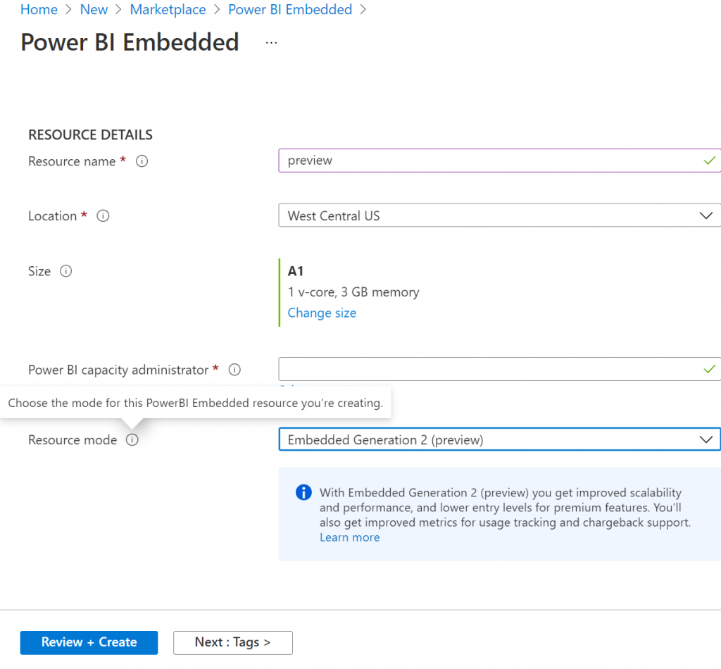
Power BI Embedded Generation 2 (preview)
Enhanced performance
Greater scale
Lower entry level for paginated reports and AI workloads
Scaling a resource instantly
Scaling without downtime
Improved metrics
Notes:
Enhanced performance– Better performance on any capacity size, anytime. Operations will always perform at top speed and won’t slow down when the load on the capacity approaches the capacity limits.
Greater scale – No limits on refresh concurrency, fewer memory restrictions and complete separation between report interaction and scheduled refreshes
Lower entry level for paginated reports and AI workloads – Customers can start with an A1 SKU and grow as they need.
Scaling a resource instantly – From scaling a Gen 1 resource in minutes, to scaling a Gen 2 resource in seconds.
Scaling without downtime – Customers can scale an Embedded Gen 2 resource without experiencing any downtime.
Improved metrics – Coming in a few weeks to simplify monitoring and metrics-based automation. Instead of various Gen 1 metrics, there will be one CPU utilization metric in Gen 2. In addition, a built-in reporting tool will allow customers to perform utilization analysis, budget planning and chargebacks.

Slide 7



Embed Power BI in Jupyter Notebooks
Power BI Jupyter Client package

Slide 8
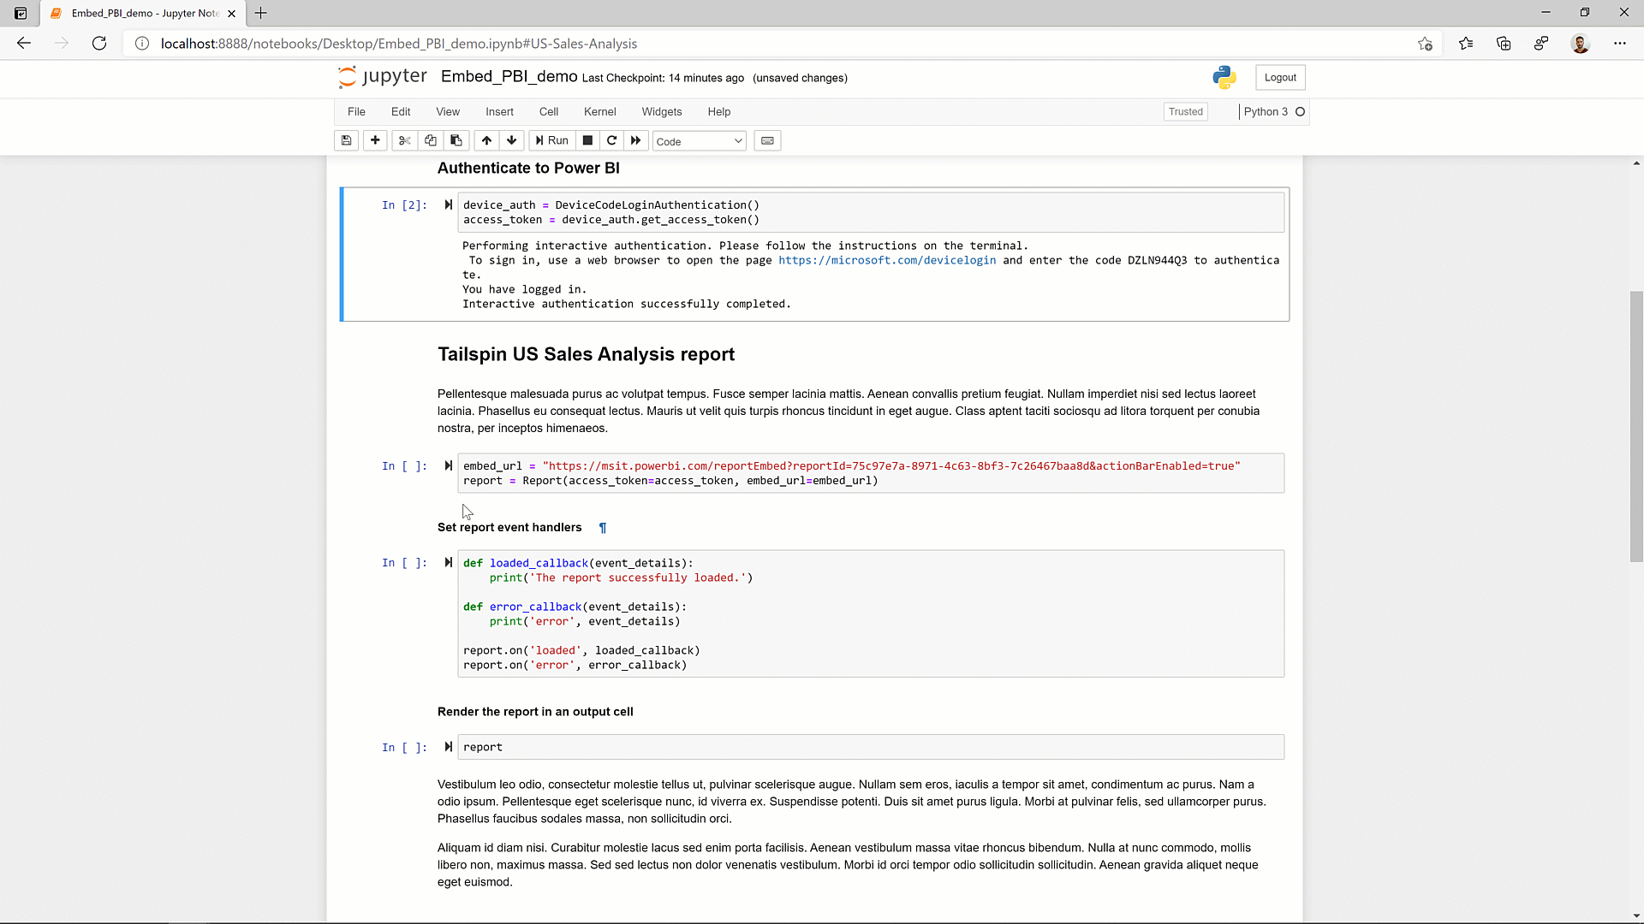
Embed Power BI in Jupyter Notebooks
Tell your data story with Power BI
Supports interactivity:
Report → Notebook (Export data)
Notebook → Report (Filter APIs)

Slide 9
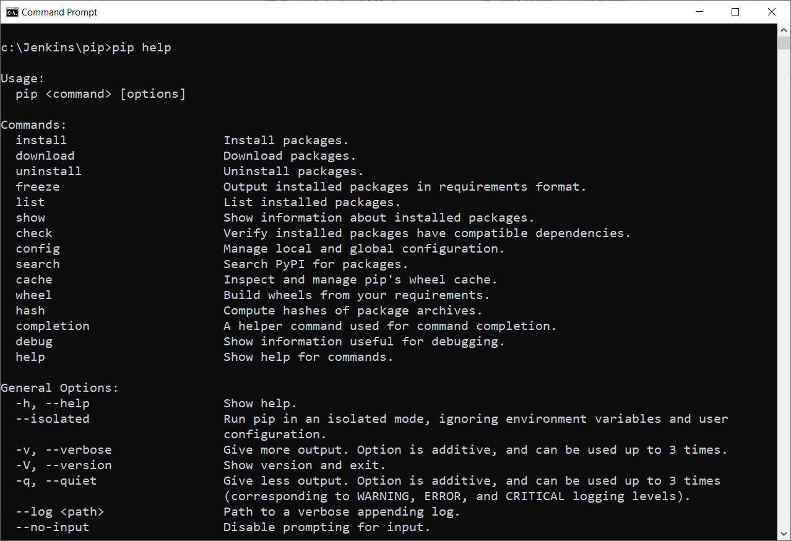
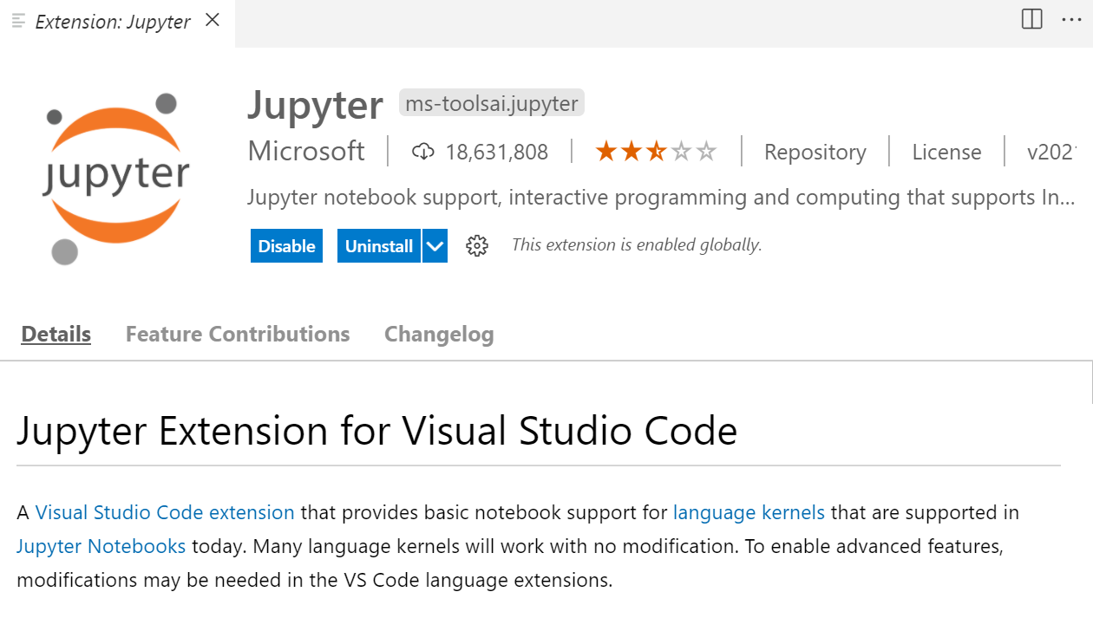
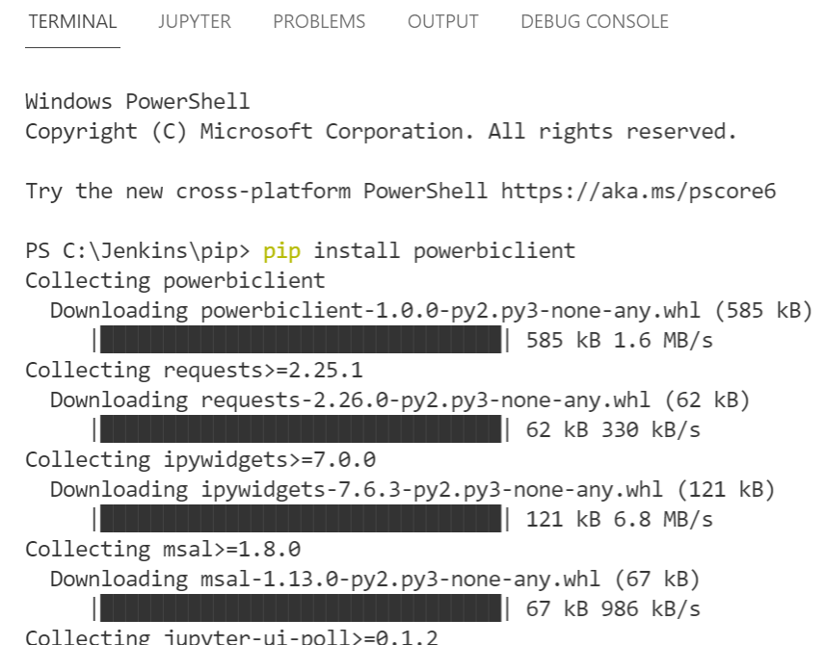
Setup the Environment
Installing PIP On Windows
Install Python latest version (3.9.6) it included PIP
Open CMD prompt and Verify pip installed pip help
Visual Studio Code
Python extension
Jupyter extension
Jupyter notebooks for PowerBI
pip install powerbiclient
pip install wheel
pip install pandas
*pandas is a software library written for the Python programming language for data manipulation and analysis.

Slide 10
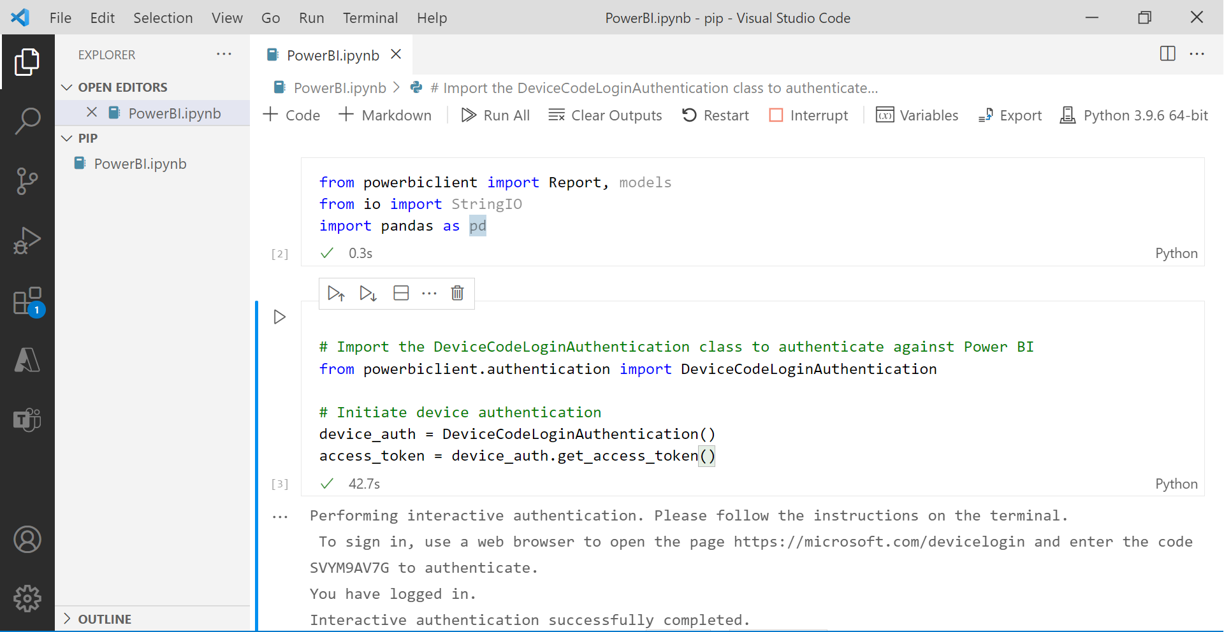

Slide 11
Demo
Get Power BI Client
from powerbiclient import Report, models
from io import StringIO
import pandas as pd
Interaction Authentication
# Import the DeviceCodeLoginAuthentication class to authenticate against Power BI
from powerbiclient.authentication import DeviceCodeLoginAuthentication
# Initiate device authentication
device_auth = DeviceCodeLoginAuthentication()
access_token = device_auth.get_access_token()

Slide 12
Demo
Get Report
group_id="70e996e2-470b-4e95-9aa6-b07fa8acf3d5"
report_id="596c85a1-1618-486b-a8e2-6b093e16f639“
report = Report(group_id=group_id, report_id=report_id, access_token = access_token)
def loaded_callback(event_details):
print('The report successfully loaded!!')
def error_callback(event_details):
print('error', event_details)
report.on('loaded', loaded_callback)
report.on('error', error_callback)

Slide 13
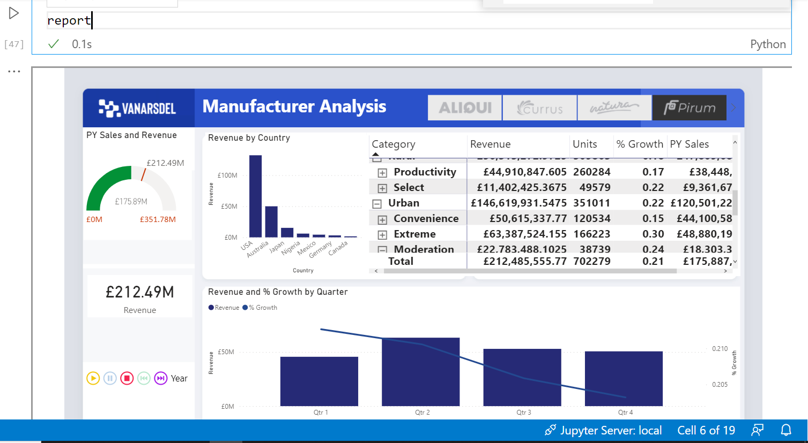
Demo

Slide 14
Demo
Get Report details
import tracemalloc
tracemalloc.start()
active_page = report.get_pages()[0]['name’]
visuals = report.visuals_on_page(active_page)
Visuals
[{'name': 'f3feab200dd10010895c', 'type': 'slicer', 'layout': {'x': 640.5194805194806, 'y': 43.24675324675325, 'z': 0, 'width': 597.2727272727273, 'height': 60.77922077922078, 'displayState': {'mode': 0}}}, {'name': 'c6012d9c7ba00c7e6bd6', 'title': 'Revenue by Country', 'type': 'columnChart', 'layout': {'x': 257.910447761194, 'y': 119.40298507462687, 'z': 1000, 'width': 294.92537313432837, 'height': 263.88059701492534, 'displayState': {'mode': 0}}}, {'name': 'bc86088011d51323506e', 'title': 'Revenue and % Growth by Quarter', 'type': 'lineClusteredColumnComboChart', 'layout': {'x': 257.910447761194, 'y': 402.3880597014925, 'z': 2000, 'width': 980.2985074626865, 'height': 259.1044776119403, 'displayState': {'mode': 0}}}, {'name': 'f9b5967bcea0167c07b2', 'type': 'card', 'layout': {'x': 41.7910447761194, 'y': 380.8955223880597, 'z': 3000, 'width': 192.23880597014926, 'height': 77.61194029850746, 'displayState': {'mode': 0}}}, {'name': 'f63b02ead35aea90d68a', 'type': 'pivotTable', 'layout': {'x': 552.8358208955224, 'y': 119.40298507462687, 'z': 4000, 'width': 685.3731343283582, 'height': 263.88059701492534, 'displayState': {'mode': 0}}}, {'name': '1f912b730a0115b2b710', 'title': 'PY Sales and Revenue', 'type': 'gauge', 'layout': {'x': 35.82089552238806, 'y': 113.43283582089552, 'z': 5000, 'width': 198.2089552238806, 'height': 202.98507462686567, 'displayState': {'mode': 0}}}, {'name': '0c98467138a540029177', 'type': 'textbox', 'layout': {'x': 247.7922077922078, 'y': 43.24675324675325, 'z': 6000, 'width': 417.2727272727273, 'height': 60.77922077922078, 'displayState': {'mode': 0}}}, {'name': 'd23bf137b61bcc201c12', 'title': 'Year', 'type': 'PBI_CV_16948668_E17D_454B_8664_2F2C470EA8C1', 'layout': {'x': 34.62686567164179, 'y': 540.8955223880597, 'z': 7000, 'width': 201.7910447761194, 'height': 57.3134328358209, 'displayState': {'mode': 0}}}, {'name': 'a96ea9f44063d174cc0e', 'type': 'image', 'layout': {'x': 34.285714285714285, 'y': 43.42857142857143, 'z': 8000, 'width': 200, 'height': 60.57142857142857, 'displayState': {'mode': 0}}}]

Slide 15
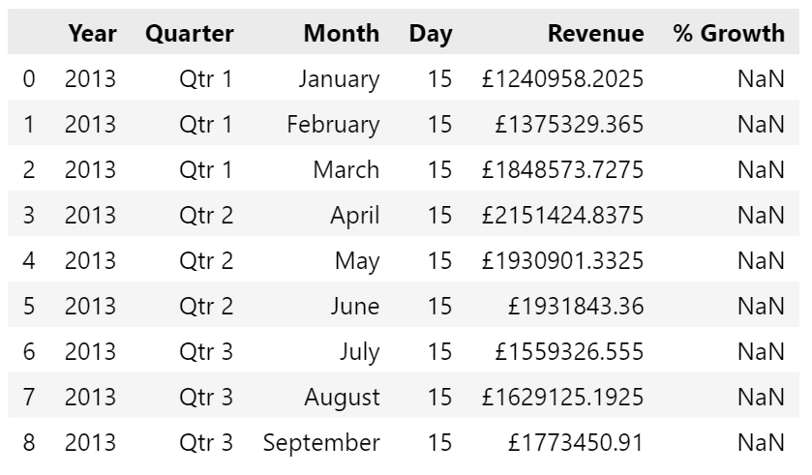
Demo
Get Particular Chart Data
visual = next(filter(lambda visuals: visuals['type'] == 'lineClusteredColumnComboChart', visuals))
visual_name = visual['name’]
visual_name
summ_data = report.export_visual_data(active_page, visual_name, rows=10)
data = StringIO(summ_data)
df = pd.read_csv(data, sep=",")
df

Slide 16
Demo
Interact with the Data
def filter_report(Year):
year_filter = {
'$schema': "http://powerbi.com/product/schema#advanced",
'target': {
'table': "Lab 1",
'column': "Year"
},
'operator': "In",
'values': [Year]
}
report.remove_filters()
report.update_filters([year_filter])
from ipywidgets import interact
interact(filter_report, Year = ['2013', '2018'])

Slide 17
Lab
https://powerbi.microsoft.com/fr-fr/blog/intro-pbi-js-api/

Slide 18
Thank you

